Slide 1
Online Reporting
Swindon and Wiltshire Growth Hub Performance
Growth Hub Governance Meeting June 2020

Slide 2
Website Traffic
Notes:
Huge increases in visitor since outbreak
Declining now as we enter recovery

Slide 3
Page Views
Notes:
Again huge increases

Slide 4
Top Pages
COVID-19 (5321)
Homepage (5064)
Knowledge: Environmental Health (2666)
News (1273)
My Hub (1049)
Top Content
Knowledge Article – Environmental Health (2666)
Knowledge Article – e-commerce: Selling to USA for UK SME’s (947)
Topics - Coronavirus: Financial Help for Businesses (864)
Knowledge Article – Costing a product or service (614)
News: Support for Wiltshire Businesses Effected by COVID (451)
Notes:
No surprises with top pages – good to see landing page for knowledge and members in top 5
Knowledge dominating content – this follows trend from newsletters – further knowledge articles to be added – see segmentation later

Slide 5
Community Membership: 1890
Notes:
Rate of take up poor – especially given the traffic – will monitor

Slide 6
Downloads
Notes:
Top docs – Environmental Protection, Food Safety, Company Accounts, Finance Terminology, Health and Safety, Appointing Directors, Cash books, SWOT analysis

Slide 7
Twitter Reach Total Followers: 2140
Notes:
Twitter continues to be our largest referrer outside of google
Taking a step back from social media as we develop the services we offer
All organic

Slide 8
Linkedin Reach Total followers: 660
Notes:
Slight increases on last year – writing specifically for Linkedin
Highly engaged audience of business professionals

Slide 9
Newsletter
Notes:
Christmas – was open to all on the database
Will segment data in future

Slide 10
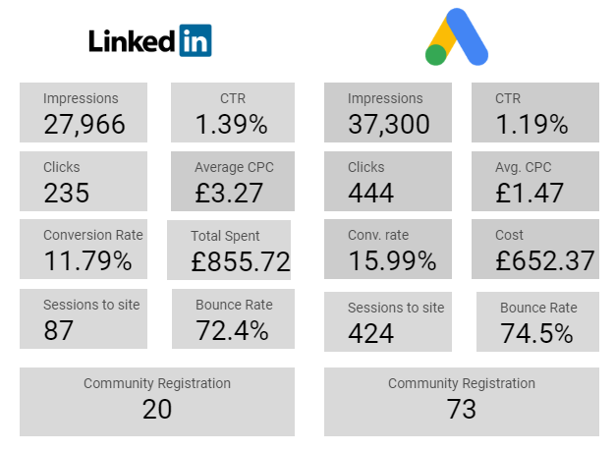
Paid Campaign
Notes:
New campaign in planning – focus on remarketing and engaging members to return

Slide 11
COVID-19 Support – Geographical Analysis
Area | Percentage
Swindon | 22%
Salisbury | 17%
Chippenham | 9%
Melksham | 9%
Bradford-on-Avon | 8%
Marlborough | 6%
Warminster | 6%
Devizes | 5%
Westbury | 5%
Amesbury | 4%
Calne | 2%
Malmesbury | 2%
Trowbridge | 2%
Corsham | 1%
Pewsey | 1%

Slide 12
COVID-19 Support Industry Breakdown
Industry | Share %
Retail | 25
Manufacturing | 16
Administrative and support | 10
Accommodation and food | 9
Health and social work | 9
Professional and Scientific | 8
Agriculture, mining and utilities | 4
Construction | 4
Real estate | 3
Education | 3
Arts and recreation | 3
Transportation | 2
Other service | 2
Financial and Insurance | 1

Slide 13
Personas (February)

Slide 14
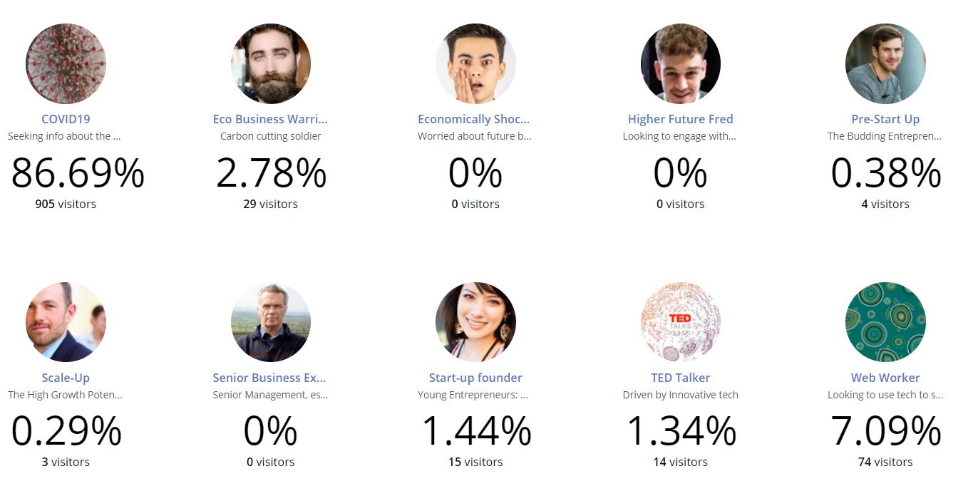
Personas (March + April)

Slide 15
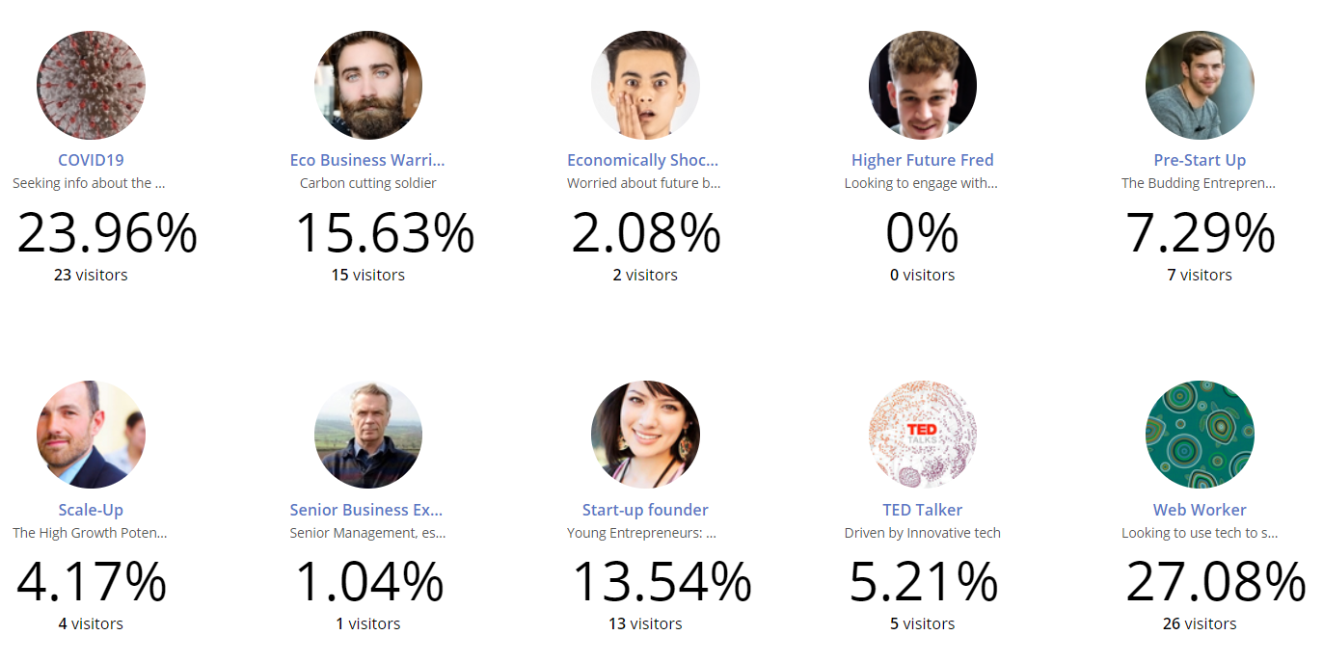
Personas (May)

